Slide 1
HTML TAGS
MCNDHS
Ms. Eng

Slide 2
AIM: HOW DO WE CREATE AN UPLOAD FORM AND A SEARCH FORM?
Do now:
Open up google Classrooms
Go to Codepen.io
TO RECEIVE GRADE:
NOTES:50%
CLASSWORK:50%

Slide 3
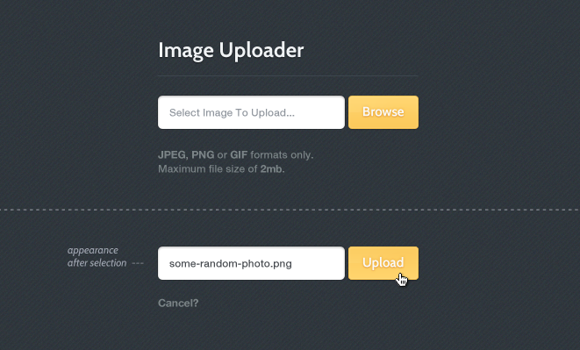
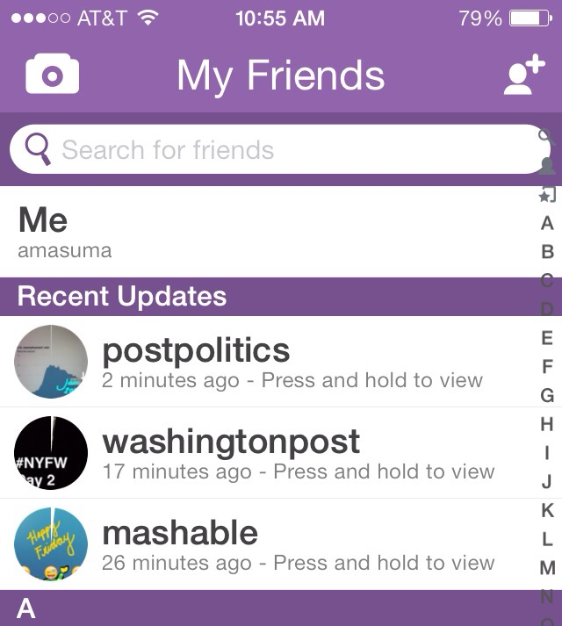
WHERE YOU SEE IT

Slide 4
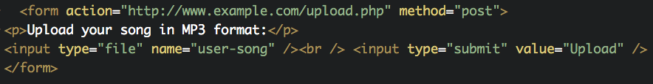
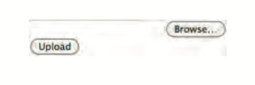
UPLOAD FORM
upload your song in MP3 format:

Slide 5
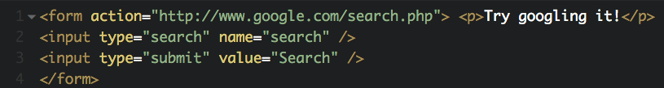

SEARCH FORM

Slide 6
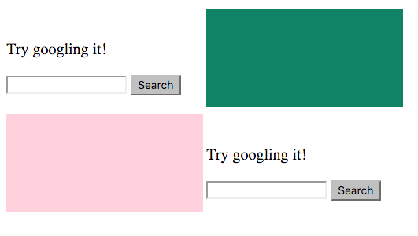
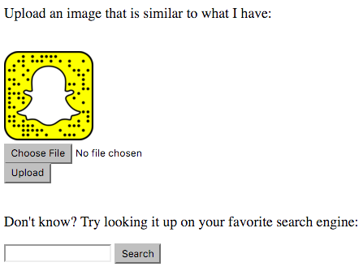
ACTIVITY

